Slide 1
ELEMENTARY STATISTICS, BLUMAN
Mean versus Median
© 2019 McGraw-Hill Education. All rights reserved. Authorized only for instructor use in the classroom. No reproduction or further distribution permitted without the prior written consent of McGraw-Hill Education.

Slide 2
Objectives for this PowerPoint
The objectives for this video are to understand the behavior of the mean and the median when extreme data values are present.

Slide 3
Example 1 (1)
A human resources employee in a manufacturing company is researching insurance plans for the company. In the process of assessing the needs for the employees of the company she has decided to find the mean and the median for the annual income of the employees.

Slide 4
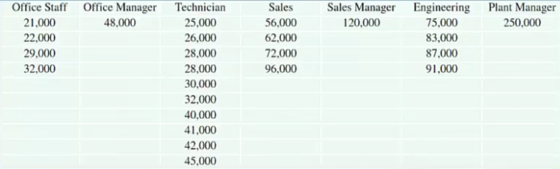
Example 1 (2)
The table below gives the annual income in dollars for each of the employees. The data are organized by job type.

Slide 5

Example 1 (3)
By organizing the data in order we can see that the financial needs and considerations for most of the employees vary considerably from those of the highest paid employees.

Slide 6
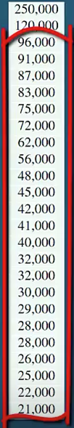
Example 1 (4)
For instance we can see that all but two of the data values are less than $100,000.

Slide 7

Example 1 (5)
In fact most of the data values range from $21,000 to $48,000.

Slide 8
Mean and Median
The mean for the data set is $59,240. Of the 25 employees 9 are above that value and 16 are below.
The median for this data set is $42,000. By definition half of the data values are less than the median and half are greater.

Slide 9
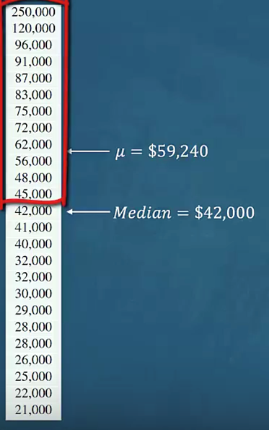
Median is Better Choice
It is easy to see that the median is a much better measure of central tendency for this data set.
Especially when considering the financial needs for the employees of this company. In situations like this where the data set contains extreme values values the median should be used as the measure of central tendency.
In situations like this where the data set contains extreme values values the median should be used as the measure of central tendency.

Slide 10
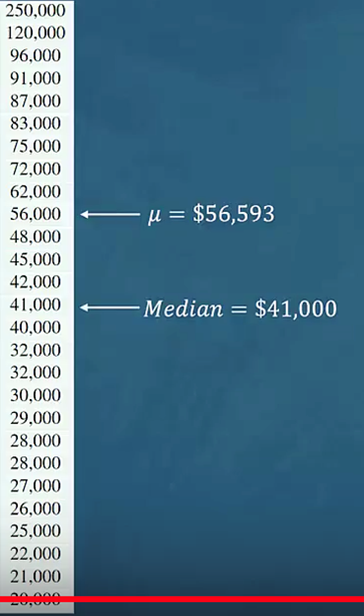
Example 2
Suppose that the company hires 2 new employees. One at $20,000 per year and the other at $27,000 per year.
These two relatively smaller data values cause the mean to decrease by $2,647 to $56,593.
The median merely moves to the next position in the data set and thus, decreases by only $1,000 to $41,000.
Since the median is not sensitive to extreme data values it is said to be a resistant measure.

Slide 11
Summary
In this PowerPoint we learned how to choose between the mean and the median as a measure of central tendency.

